Slide 1
Increasing Student Motivation Using Problem-based Learning
A Teachers In Action Project by:
Tonya Bull-Kelly and Heidi Nixon/Jennie Bartlett
June 2016

Slide 2
Background Information

Slide 3
Background Information: Town of Torbay, NL
The town of Torbay is located on the Eastern side of the Avalon peninsula, 12 kilometres North of St. John's. It is a part of the St. John's Metropolitan area.
The name "Torbay" originated from Torbay, Devon, England and was first mapped in 1615 by John Mason. The name comes from the old Anglo-Saxon word "tor" which means a "rocky hill".
Both locations are geographically similar in that they have wide open bays that face in a North-easterly direction. (Wikipedia)

Slide 4
Background Information: Holy Trinity Elementary
The three participants in this TIA project were: Tonya Bull-Kelly, and Heidi Nixon/Jennie Bartlett. All are teachers at Holy Trinity Elementary School in Torbay.
Holy Trinity Elementary School is currently a K-6 school comprised of approximately 850 students from the Torbay community.

Slide 5
Background Information : Tonya
Tonya Bull-Kelly is a a Grade Four French Immersion teacher at Holy Trinity Elementary.
She has been an educator for 19 years and has a diverse background of teaching experiences.
She spent her first nine years of teaching in Happy Valley- Goose Bay, Labrador. Presently, she teaches grade four French immersion.
Her current class consists of 27 students: 13 boys and 14 girls.

Slide 6
Background Information : Heidi/Jennie
Heidi Nixon is a grade four French Immersion teacher at Holy Trinity Elementary.
She has been an educator for 12 years and has a diverse background of teaching experiences.
Heidi teaches grade four French immersion and her current class consists of 26 students: 11 boys and 15 girls.
During the implementation of this project, Jennie Bartlett was on a 4-month replacement (December-March).

Slide 7
Classroom Composition
We believe that:
Children learn best when presented with holistic problem-solving challenges where they can collaborate, communicate and think critically and creatively with their peers.
Children need to be motivated and encouraged in order to maximize the success of learning potential.
We joined this project to increase our abilities to motivate our students when teaching Science and to encourage young engineers to become life long problem solvers.

Slide 8
Focus Area

Slide 9
Focus Area
Our focus was on increasing student motivation using problem-based learning in the French Immersion classroom.
The Inquiry-based Learning Model was a key component in achieving our focus.

Slide 10
Inquiry-based Learning Model

Slide 11
Focus Area
We noticed a trend in our classes that children needed to become more independent problem-solvers in all areas of the curriculum, including during real-life experiences.
We decided to give our students more opportunities to engage problem-solving skills independently through our design task challenges.
During a 4-week S.T.E.M. Block, there were 10 design task challenges implemented by the students. Each week, each group of 3 students, explored three design tasks.

Slide 12
Research Questions

Slide 13
Research Questions
What is our role in implementing problem-based learning in our classrooms?
How will problem-based learning in our French Immersion classrooms affect student motivation?

Slide 14
Ethical Considerations
For this project, we created and sent home an informative letter as well as a consent form to be completed by parents/guardians.
A consent and photo release form was also sent home from Memorial University of Newfoundland and one from our school.

Slide 15
Parent Letter & Consent

Slide 16
Planning

Slide 17
Planning
Regular communication with Tom Walsh and his insight, suggestions and encouragements were instrumental in guiding us during this project. (Insert photo of him with our students)
We utilized our seven release days to collaborate on ideas, plan lessons and activities, as well as to gather materials. We used many opportunities throughout the school day to meet and discuss our project.

Slide 18
Planning
In order to meet the requirements of this project, we completed the following:
TIA participant institute at MUN in August
professional development day at Holy Trinity Elementary
7 release days at MUN
read literature and articles provided by the MUN Leadership Team
collaborated with colleagues

Slide 19
Implementation

Slide 20
Implementation
From the database of design task challenges provided by Tom, as well as using outcomes from the grade four Science curriculum, we selected ten design task challenges to use during our S.T.E.M. Block.

Slide 21
Implementation
Students were placed into collaborative groups of 3. In groups of 3, students worked together eliminating the possibility of subgrouping.
Each week, 3 design task challenges took place simultaneously.
By the end of each week, all students had completed all three different design task challenges.
Students were responsible for completing a written response for each design task challenge.
Work samples and responses were collected and stored in S.T.E.M. duotangs.

Slide 22
Implementation
During reflection and discussion on the 3-week S.T.E.M. Block, we decided to run one more design task challenge using a different format.
This time, all students, working in groups of 3, participated in the same design task challenge simultaneously.

Slide 23
Design Task Challenges

Slide 24
Our Design Task Challenges
Chair Design/Construire une chaise (Introductory Challenge)
Shadow Number Puppets/Les ombres
Raybox/Boîte au miroir
Rollercoaster Design/Construire une montagne russe (led by Tom)
Aluminum Foil Boat/Construire un bateau du papier d’aluminium
Refraction/Réfraction
Marshmallow & Noodle Tower/Tour en guimauve et pâte
Periscope/Construire une périscope
Parachute Design/Parachute
Zipline/Une tyrolienne
Derby Car Design/Construire une voiture

Slide 25
Introductory Design Task Challenge: Design a chair/Construire une chaise

Slide 26
Design Task Challenge #1: Shadow Number Puppets/Les ombres

Slide 27
Design Task Challenge #2: Raybox/Boîte aux miroirs

Slide 28
Design Task Challenge #3: Rollercoaster Design/Construire une montagne russe (led by Tom)

Slide 29
Design Task Challenge #4: Aluminum Foil Boat/Construire un bateau du papier d’aluminium

Slide 30
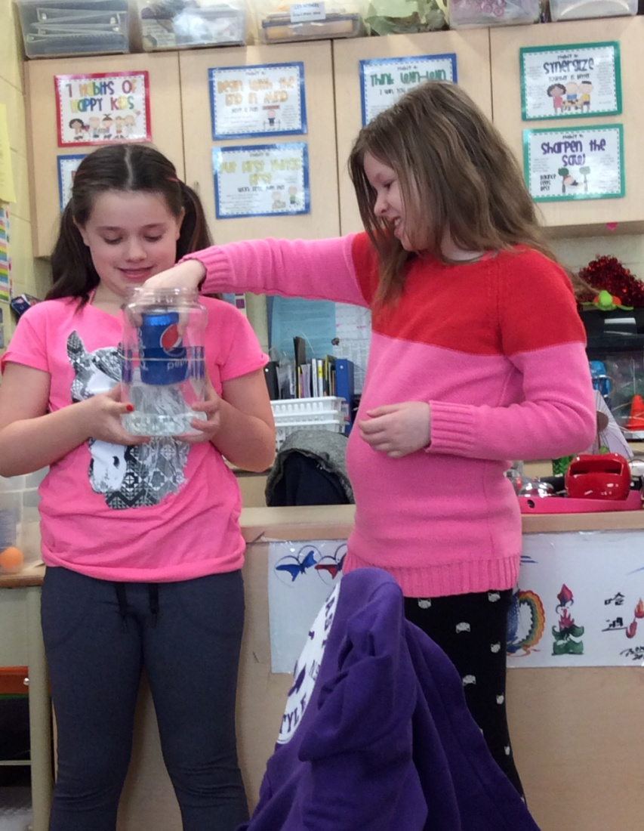
Design Task Challenge #5: Refraction/Réfraction

Slide 31
Design Task Challenge #6: Marshmallow & Noodle Tower/Tour en guimauve et pâte

Slide 32
Design Task Challenge #7: Periscope/Construire une périscope

Slide 33
Design Task Challenge #8: Parachute Design/Parachute

Slide 34
Design Task Challenge #9: Zipline/Une tyrolienne

Slide 35
Design Task Challenge #10: Derby Car Design/Construire une voiture

Slide 36
Data Collection

Slide 37
Data Collection
Data was collected using the following sources:
surveys
observations
student conferencing
work samples
videos (using the iPad)
photographs (using the iPad)

Slide 38
Data Collection
Students completed several surveys throughout this process. Before we initiated the S.T.E.M. Block, we administered two student surveys.
The first survey was created to gauge students' understanding of what constitutes problem-solving.
The second survey was to gain information about students' interests and learning styles.

Slide 39
Data Collection: Student Surveys

Slide 40
Data Collection
Surveys were also administered during and post S.T.E.M. Block to gain an understanding of students' perceptions of the S.T.E.M. Block.
Upon completion of the 3-week S.T.E.M. Block, the initial two surveys were re-administered.
A final survey, post-S.T.E.M. Block, allowed students to reflect and share their experiences during the S.T.E.M. Block.

Slide 41
Data Collection: Post-S.T.E.M. Student Surveys

Slide 42
Data Collection
We ensured our data collection was trustworthy (valid and reliable), by:
Using multiple data sources as triangulation.
Using consistent variables in our execution of the design task challenges.
Repeating some of the pre- and post surveys of the design task challenges to compare results.
Discussing our implementations of each activity to ensure consistency in our classroom teaching.
Following parental/guardian consent in student involvement.

Slide 43
Results

Slide 44
Results Pre-Surveys Indicators
In administering the pre-S.T.E.M. Block surveys, we noticed that:
The majority of students expressed that problem-solving was when you had a problem to solve.
Students recognized that problem solving occurred in various situations (i.e. needing a pencil, conflict with peers, or a Math question).

Slide 45
Results Pre-Surveys Indicators
Out of the 52 students who participated in the pre-S.T.E.M. Block surveys, we noticed that:
54% of students like Science
69% of students prefer to do Science experiments in class
44% of students prefer problem-solving
54% of students indicated that they use problem solving everywhere

Slide 46
Results Mid-Surveys indicated…
In administering the mid-S.T.E.M. Block surveys, we noticed that:
The majority of students enjoyed doing the hands-on investigations.
The majority of students felt that they had a better understanding of the light unit after completing some of these hands-on investigations.
Some students indicated an interest in participating in more hands-on investigations in the future.

Slide 47
Results Post-Surveys indicated…
In administering the post-S.T.E.M. Block surveys, we noticed that:
The majority of students could give an example or explain a representation of S.T.E.M. in their classroom
The majority of students felt that the S.T.E.M. Block was important in the Grade 4 classroom

Slide 48
Results Post-Surveys Indicators
Out of the 50 students who participated in the post-S.T.E.M. Block surveys, we noticed that:
72% of students like Science
60% of students prefer to do Science experiments in class
38% of students prefer problem-solving
66% of students indicated that they use problem solving everywhere

Slide 49
Results Therefore…
During the implementation of our S.T.E.M. Block, we noticed the following:
Students prefer hands-on authentic activities where they work collaboratively in small groups of 3.
Students need to be involved in the learning process and they need to design and create for themselves.
Students enjoy problem-solving when presented with engaging, holistic, and challenging design tasks.
Students were more original in creative design process when the whole class (in groups of 3) worked simultaneously on the same design task challenge.

Slide 50
Student Reflections: What is S.T.E.M.?
“S.TE.M.” is about brain exercise – it is important for our physical brain strength.”
“S.T.E.M. is when you are given a task and problem and you must make something to help solve that problem.”
“S.T.E.M. is important because now we know how to be young engineers.”
“Before we did S.T.E.M., I hated Science. Now I love it so much, I may even do one of these projects at home!”
“We make it, we build it, and we do it!”

Slide 51
Student Reflections: What is S.T.E.M.?

Slide 52
Teacher Inquiry

Slide 53
Teacher Inquiry
Strengths
Challenges
Students had opportunities to work collaboratively
Students enjoyed hands-on authentic challenges
Students were engaged in learning
Students worked independently
Students worked as problem-solvers
Time to plan and gather/prepare materials
Documenting student data while conferencing with student groups.
Preparing design tasks into French
Teaching of French vocabulary prior to tasks
Adapting our S.T.E.M. Design Task Challenges to incorporate all curriculum components of the Grade 4 Science program.

Slide 54
References
Articles:
Ansberry, K. & Morgan, E. (2008). Rollercoasters.
Banchi, H. & Bell, R. (2008). The many levels of Inquiry.
Everett, S. & Moyer, R. (March 2007). Science and Children “Inquirize” Your Teaching: A guide to turning favourite activities into inquiry lessons.
Letterno-Perdue, P., Bolotin, S., Benyameen, R., Brock, E. & Metzger, E. (2015). The EDP-5E: A rethinking of the 5E replaces exploration with engineering design.
Tuttle, N., Stanley, W., & Bieniek, T. (January 2016). Science and Children Engineering Motion: First graders build derby cars while practicing communication skills.
Text:
Dana, N. & Yendoi-Hoppey, D. (2014) .The Reflective Educator’s Guide to Classroom Research 3rd Edition: Learning to Teach and Teaching to Learn Through Practitioner Inquiry.
Websites:
www.torbay.ca
https://en.wikipedia.org/wiki/
www.mun.ca/tia
Other Resources:
Database of Design Task Challenges (provided by Tom via Smart Chick Teaching Resources)

Slide 55
Credits
Thank you to the following key players in assisting our project success.
At Memorial University of Newfoundland:
Craig Adams
Karen Goodnough
Keith Power
Tom Walsh
At Holy Trinity Elementary School:
Administration: Debbie Peddle, Bernadette Kolonel, and Rodney Mitchell
Grade 4 French Immersion Students
Grade 4 French Immersion Parents/Guardians
Jennie Bartlett
Staff and Colleagues
And special thanks to Rodney Kelly, our resident S.T.E.M. Design Challenge Materials Contractor, as well as Brad Etheridge, for your moral support!
Sincerely,
Tonya and Heidi (2016)

Slide 56
Thank you/Merci! (Click for Video)

